Slide 1

Modern Education
Key approaches and practical classroom strategies

Slide 2

Introduction
Modern education shifts from teacher-led delivery to student-centered, skills-focused learning. Emphasis is on real-world relevance, technology integration, and continuous assessment.
Main goal: prepare adaptable learners ready for complex challenges.

Slide 3

01
Modern Pedagogy

Slide 4
Learner-centered
Focus on student agency and personalized pathways. Activities emphasize projects, collaboration, and reflection, enabling deeper engagement.
Teachers act as facilitators, guiding inquiry and supporting individual growth.

Slide 5

Competency-based
Students progress by demonstrating mastery, not time spent in class.
Use frequent formative checks and flexible pacing to ensure skill acquisition and meaningful feedback. Mastery over seat time

Slide 6
Assessment strategies
Use formative checks and varied methods to measure progress, not just exams.
Implement frequent feedback loops and performance tasks to guide learning and adjust instruction.

Slide 7

02
EdTech Integration

Slide 8
Digital tools
Select tools that support collaboration, creativity, and assessment. Prioritize usability and alignment with goals.
Train teachers and monitor impact to ensure meaningful adoption and avoid tech for techs sake.

Slide 9
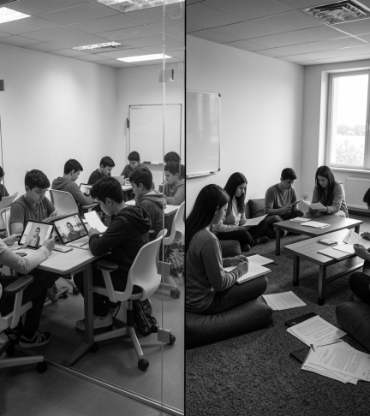
Hybrid classrooms
Blend synchronous and asynchronous activities for flexibility and engagement.
Design clear routines, equitable access plans, and concise digital materials to maintain learning continuity.

Slide 10
Data privacy
Protect student data with strict policies, consent protocols, and secure platforms.
Limit data collection to essentials and conduct regular audits to ensure compliance and trust. Privacy first.

Slide 11
Conclusions
Focus on learner outcomes, not tools. Combine pedagogy with purposeful technology and robust assessment.
Ensure equity, privacy, and ongoing teacher support for sustainable modernization.

Slide 12

Thanks!
Do you have any questions?
youremail@freepik.com
+34 654 321 432
yourwebsite.com
Please keep this slide for attribution

